Slide 1
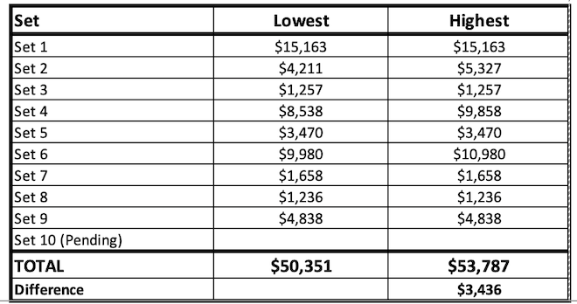
TOTAL ESTIMATE

Slide 2
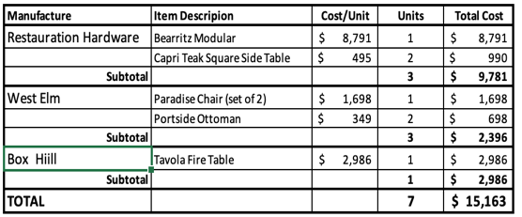
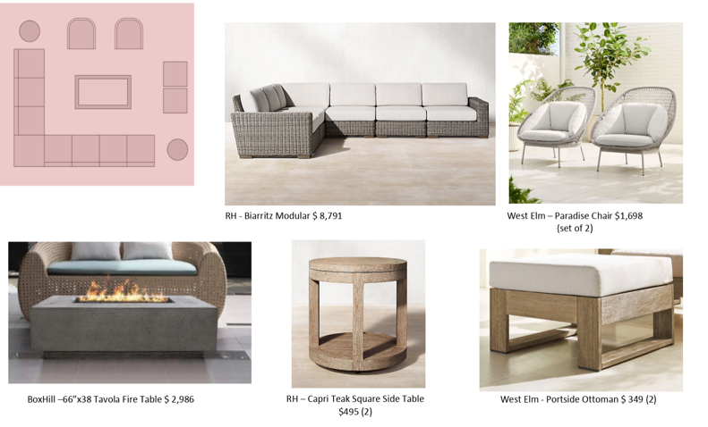
SET 1 ESTIMATE

Slide 3
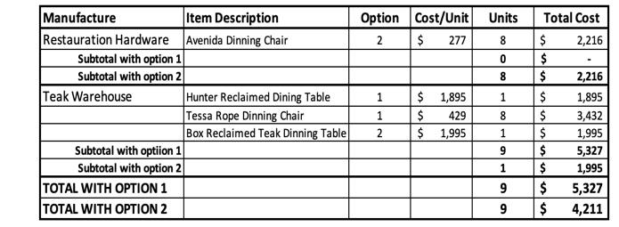
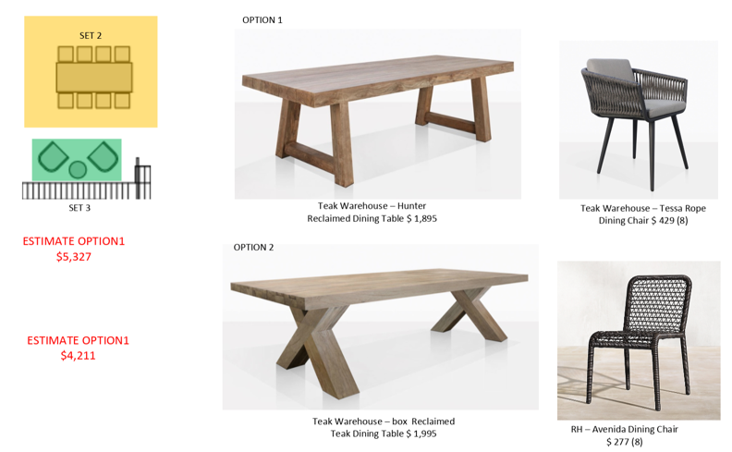
SET 2 ESTIMATE Dinning

Slide 4

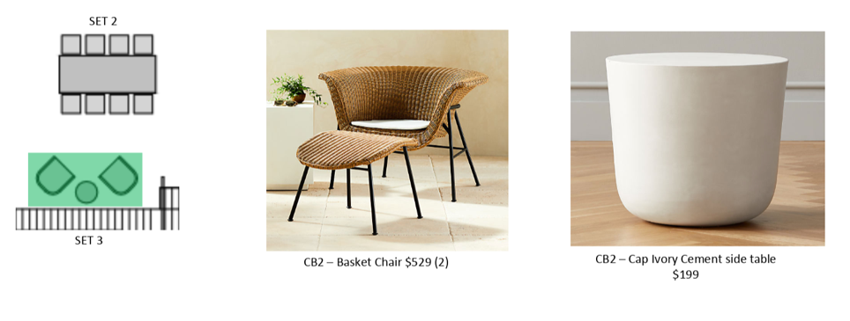
SET 3 ESTIMATE Dinning

Slide 5
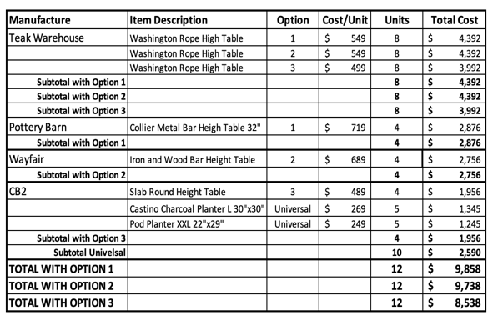

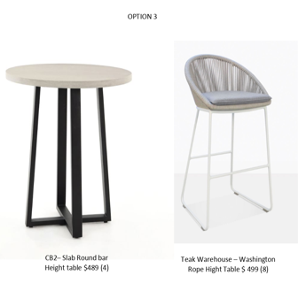
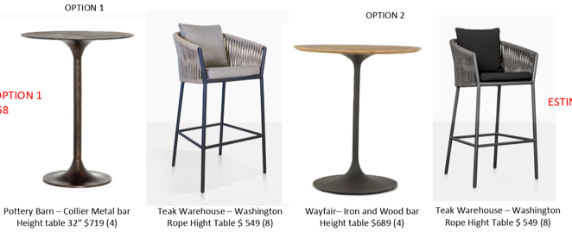
SET 4 ESTIMATE Dinning
OPTION 3

Slide 6

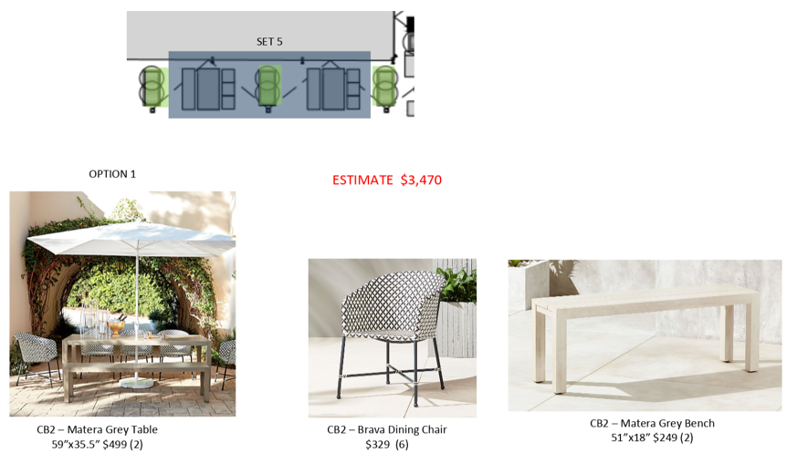
SET 5 ESTIMATE Picnic Tables

Slide 7

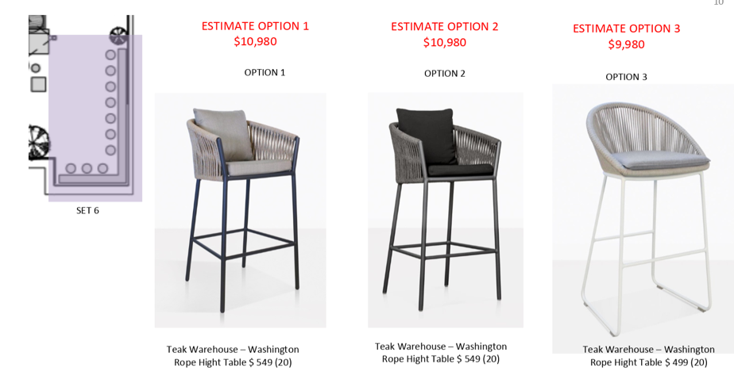
SET 6 ESTIMATE Bar Area

Slide 8

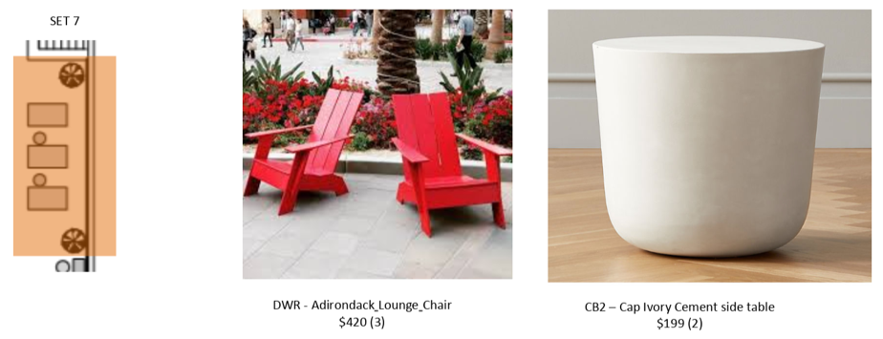
SET 7 ESTIMATE Bar Area

Slide 9

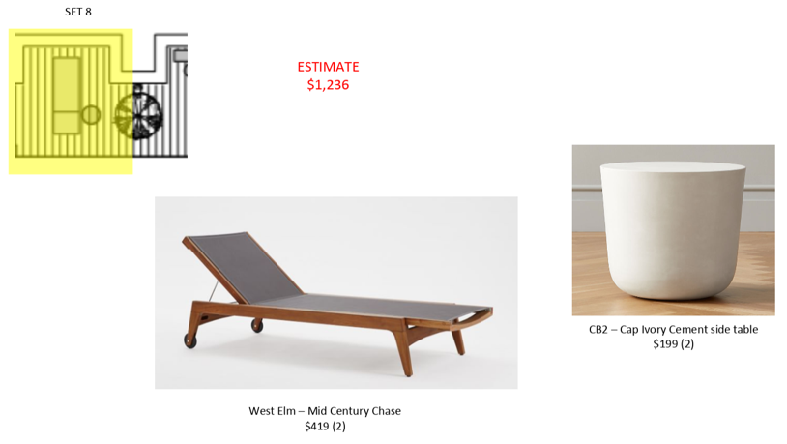
SET 8 ESTIMATE

Slide 10

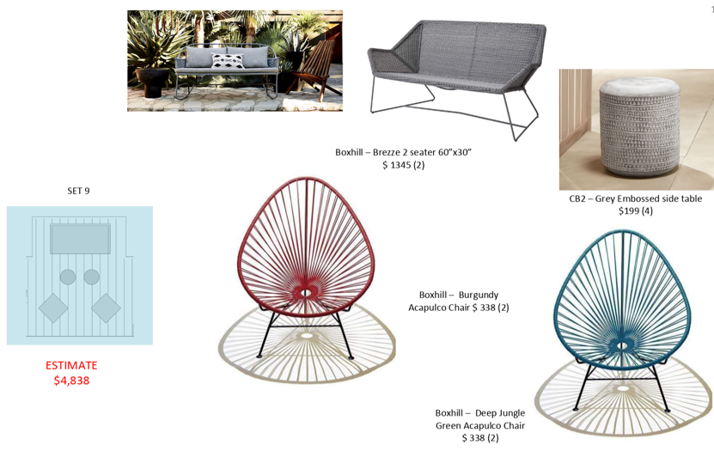
SET 9 ESTIMATE

Slide 11

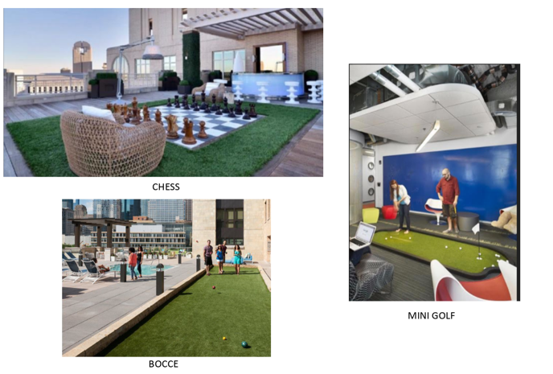
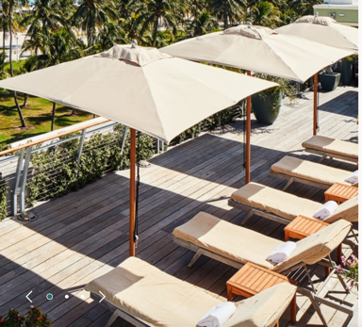
SET 10 ESTIMATE Gaming & Umbrellas

